Slide 1
ALGEBRA 4
Day 64

Slide 2
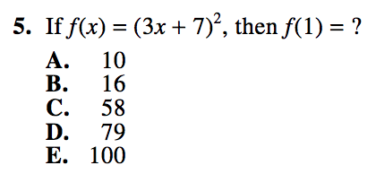
Bell Work

Slide 3
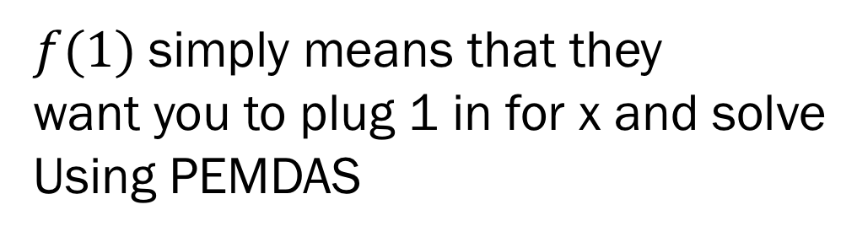
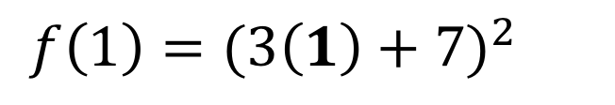
Bell Work Answer:
$f(1)$simply means that they
want you to plug 1 in for x and solve
Using PEMDAS
Type this straight into your calculator!
DO NOT BE A HERO!!!
$f\left(1\right)=(3\left(1\right)+7)^{2}$
The answer is: E.) 100

Slide 4
ACT DAY 4
Full ACT Math Test (sophomores and juniors)
Yellow Test in Box at front of room
Full College Math Placement Exam (seniors)
White Packet next to box at front of room
Please make sure all mini tests, and the abbreviated tests are complete as we will be going over them next class.

Slide 5
Guidelines for Today
You will be given a full ACT packet (we are only going to do the MATH section in class… you can complete the other sections on your own)
Seniors will be given an Math Placement Exam used at UNL (other colleges use a similar test)
Both tests allow for 60 minutes to complete

Slide 6
Tips for Taking the Mathematics Test
Pace yourself
Use calculator wisely
Solve the problem
Locate the solution among the answer choices
Make sure you answer the question
Make sure your answer is reasonable
Check your work

Slide 7
Where to write your answers and show your work
ACT – There is a bubble sheet at the back of the test booklet… Tear it off and use it!
The math test is section 2. (There are five choices of answers, and 60 problems it should be easy to identify where to fill in your answers). (see next slide of visual).
I would HIGHLY suggest using the bubble sheet for answers, as this will be the format for the ACT next week. Show all work in the test booklet.
Math Placement – Circle answers on the hand out. Use a separate sheet of paper to show your work

Slide 8
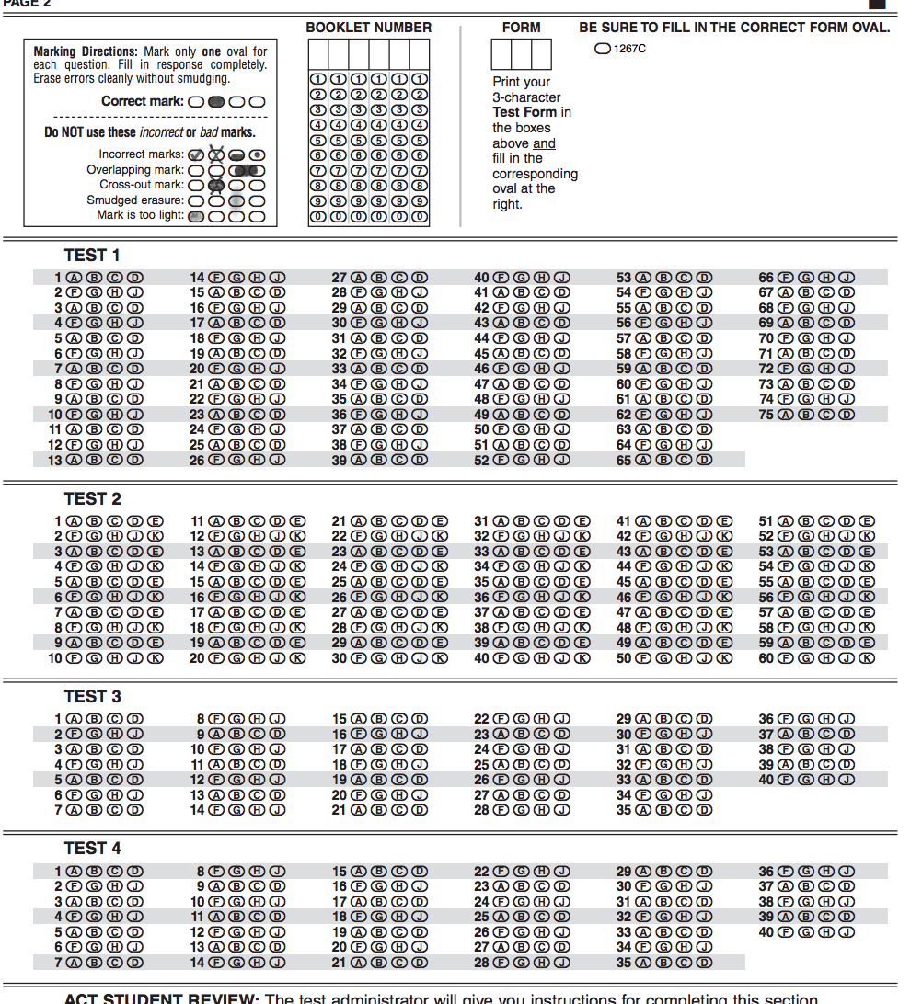
English Section
Put math
answers in
this section
Math Section
Reading Section
Science Section

Slide 9
Calculators can be used on both tests

Slide 10
Before you begin the test
Make sure you have a pencil that is sharpened and a calculator
Please read the following directions together as a class before beginning the test
No one will talk, except when your instructor warns you that there is only “5 minutes remaining on this test”

Slide 11
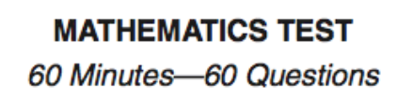
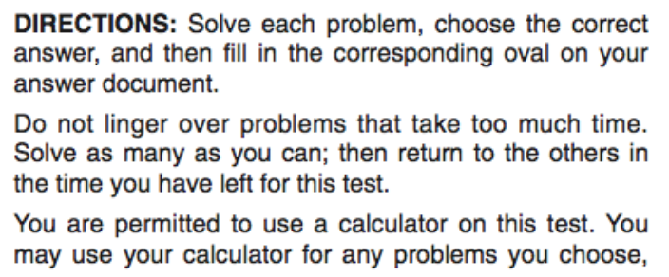
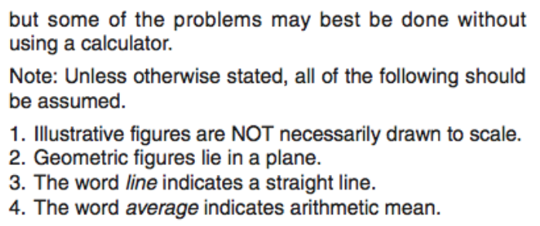
You are to remain silent and work on this test only. After reading the directions the teacher will stay: “You’ll have 60 minutes to complete this section of the test. You may begin now”

Slide 12
During the test: Your teacher will fill in the times on the following chart and leave it on the board for the duration of the test:
Test Start Time: ___________
Teacher will announce “5 minutes left” at: ___________
Test End Time: ___________ Teacher will say: “Put down your pencils the math test is now over” And move on to the next slide.
If you finish early, go back and check your answers, and please remain quiet for other students who are testing.

Slide 13
At the conclusion of your test:
Please use the back of the booklet to check your answers. (page 56 the “–” line tells you the type of problem)
Record on the bottom of page 56 how many of each type of problem you got correct (we’ll use this as a baseline of where to study, and for comparison on your actual ACT for a grade)

Slide 14
Collect all of your practice tests in one place… you should have the following:
3 mini tests (4 after today)
An abbreviated test (green packet)
A full ACT booklet (from today)
We will be turning them all in at the start of next week

Slide 15
The last 15 – 20 minutes of class
You can work on previous Mini Tests (these will all count as your homework score for the semester and ultimately a formative quiz score based on completion and growth)
We’ll have our last Mini Test passed out now
If you want another FULL ACT they are available in a box behind my desk… this is not required, just additional resources if you would like (some of you may already have the test)

Slide 16
Homework/In class work for next time
Attempt Mini Test 4
Set a timer for yourself for 10 minutes and try to get all 10 problems done
-- OR --
Set a timer and work through all the problems until you are complete and see how long it took you.

